Slide 1
Multiplying numbers, but you are a tired seventeenth century scientist
https://tinyurl.com/LOGsigma

Slide 2
Math is not as simple without calculators
Common household things are very difficult to compute without a calculator
Sine, cosine, inverse of secant…
Square root (or roots in general)
Multiplication (32647624.24139 x 471380478.8183)
Division
In order to overcome these difficulties, people came up with several devices and algorithms.

Slide 3
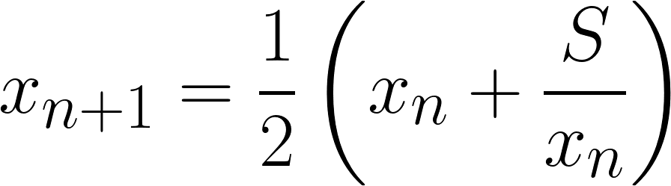
Calculating square roots
Useful for several formulae (Pythagoras, area of triangle, etc.)
Heron’s method
Division!
In practice, they looked up tables
Next estimate
for √S
Previous estimate
for √S

Slide 4
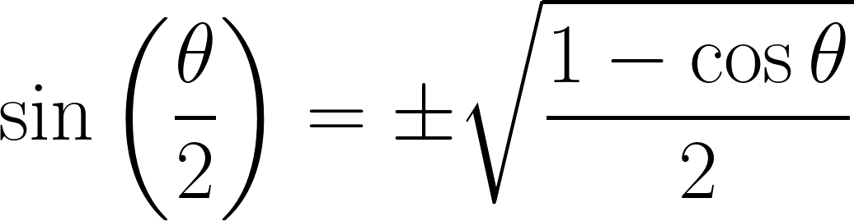
Calculating trigonometric functions
Extremely useful for basically everything, especially astronomy
Half-angle formula:
Root!
In practice, people looked up tables

Slide 5
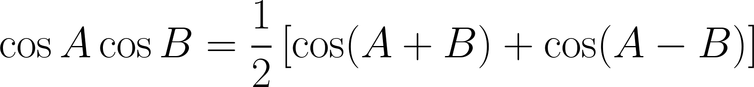
Multiplying
As important as… multiplication
Prosthaphaeresis!
Sum the angles and look up the cosine
“Convert” your number to a cosine (38.9 → 0.389) and look up the corresponding angle (cos⁻¹0.389 = 67.108º)
Do the math and then “revert” to the original number (0.253 → 25.3)

Slide 6
Problems with prosthaphaeresis (cf. this pdf)
In order to use it for division, you also need tables for secant
If you use degree-minute-second to measure angles like early scientists, summing and subtracting angles is not that easy
You still have to divide by 2!!!
Only way of calculating powers of numbers is through repeated multiplication… how about fractional powers?

Slide 7
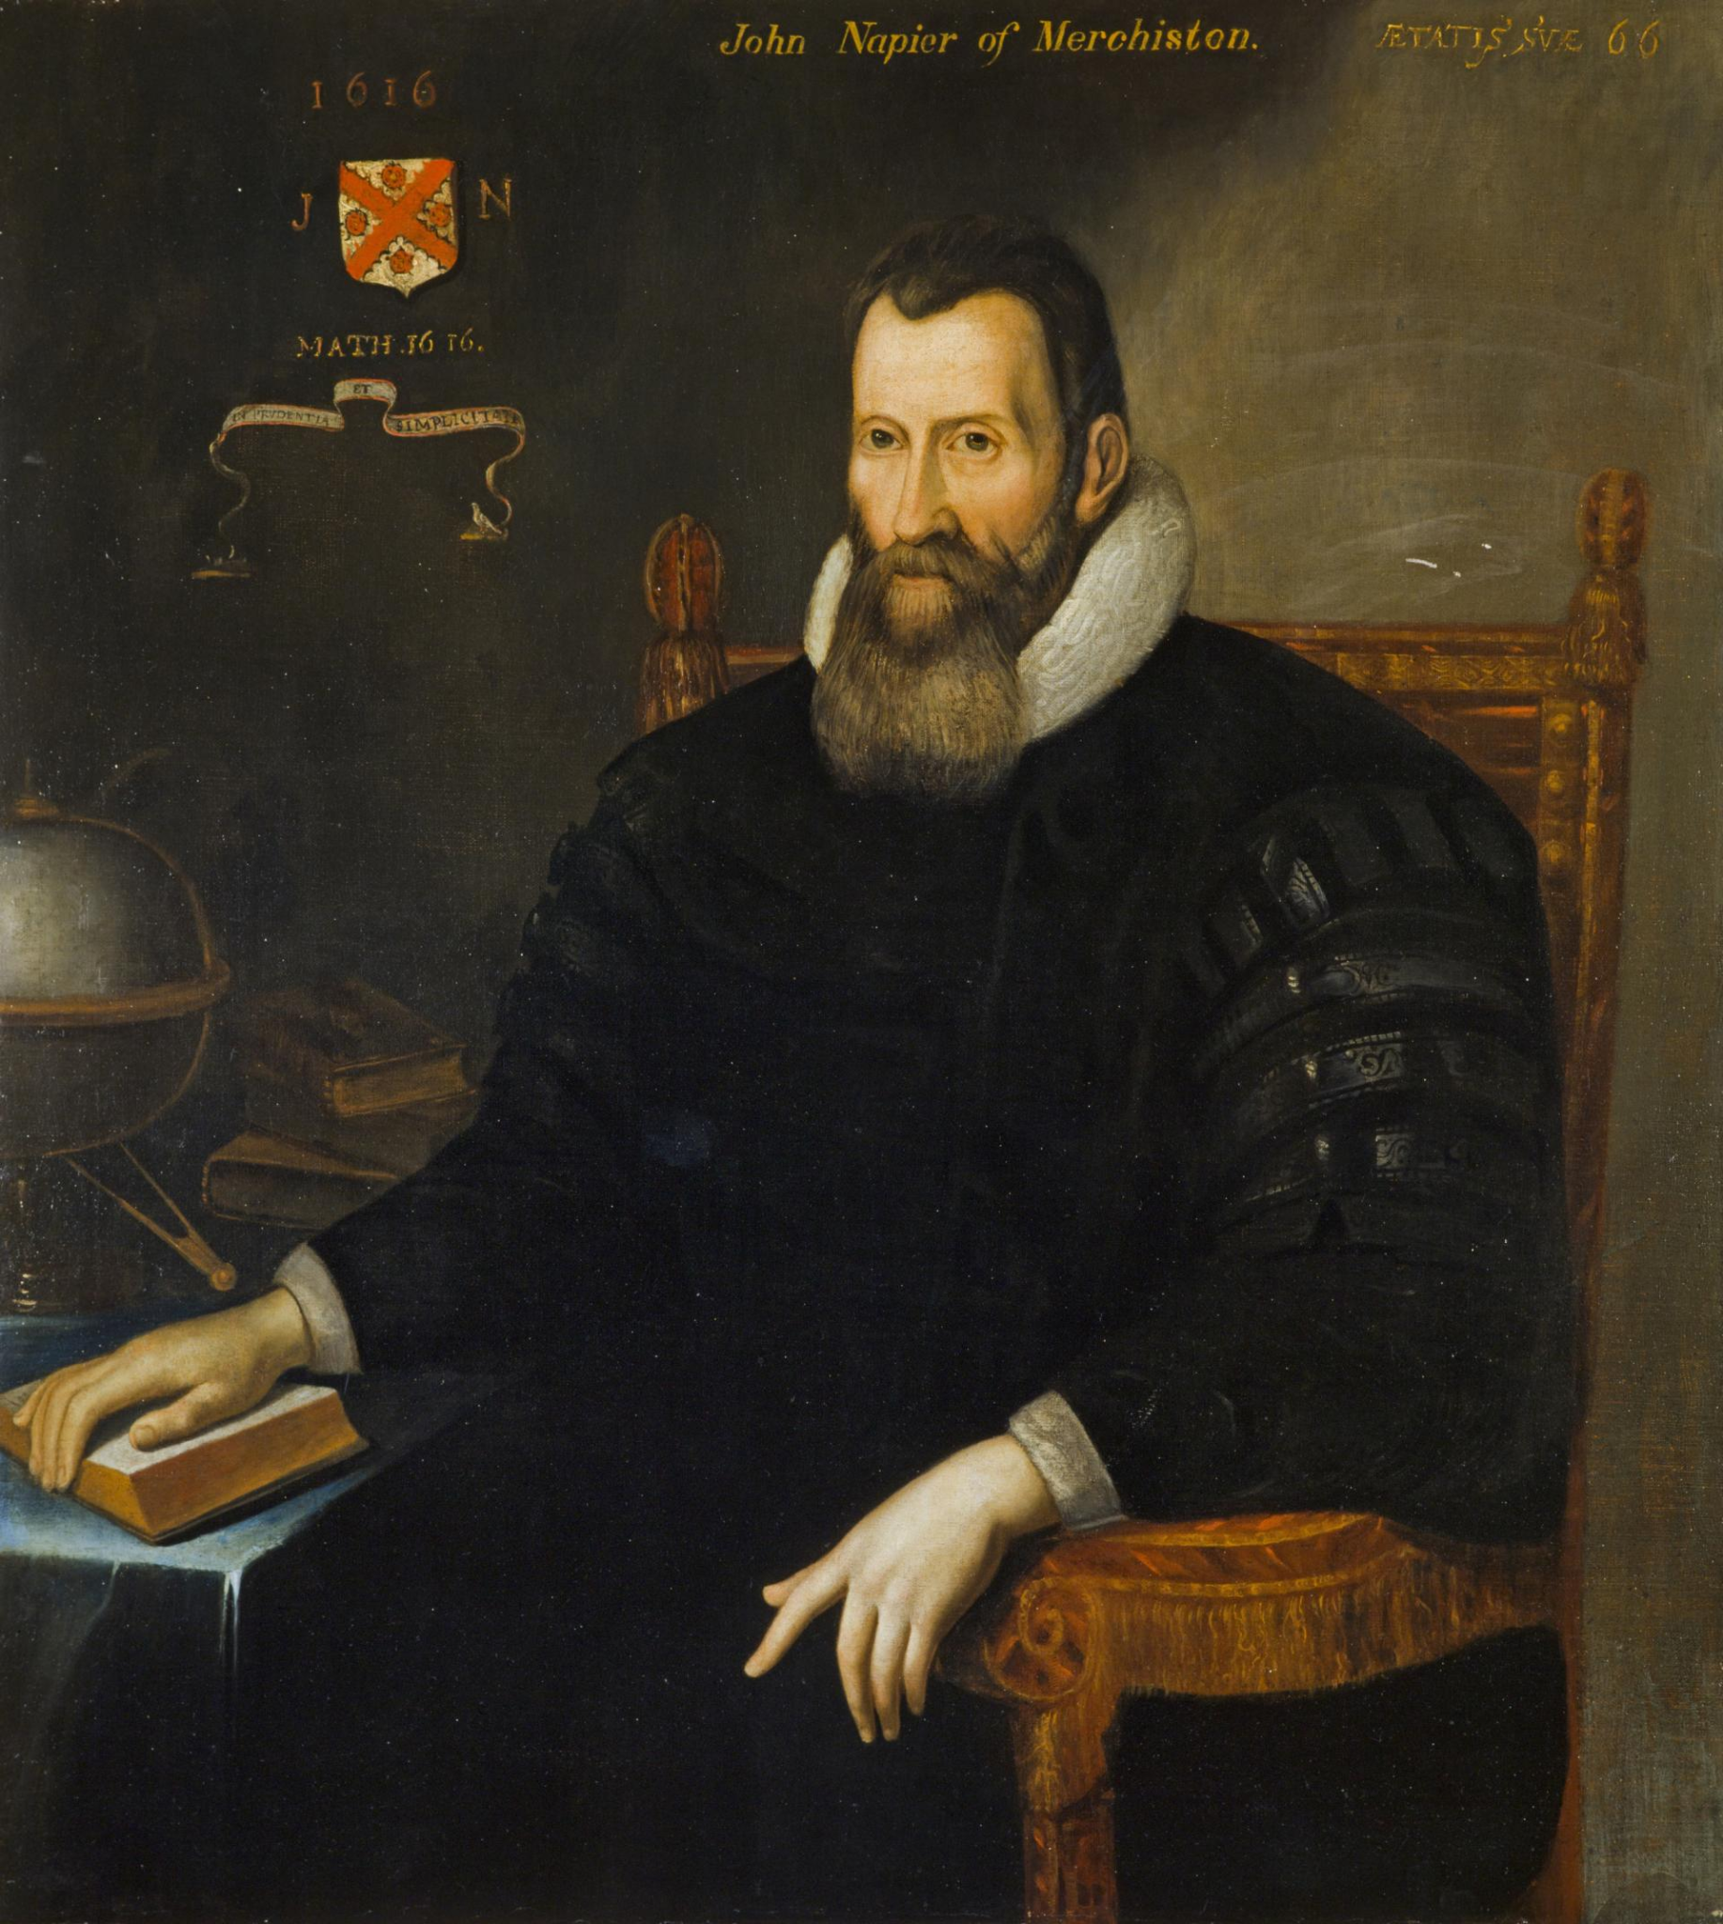
John Napier
Jobs:
Being a noble
Improving mathematician’s lives
Invented tools for computing and the logarithm

Slide 8
A motivation for logarithms
Above: constant speed
Below: speed proportional to distance from origin
1 2 3 4 5 6 7 8 9 10
2 4 8 16 32 64 128 256 512 1024
Key realisation: the intervals above being in arithmetic progression corresponds to the intervals below being in geometric progression

Slide 9
The reason it is useful
Because this line is in arithmetic proportion, we know where it will be after t1 + t2
t2
t1
t1 + t2
1 2 3 4 5 6 7 8 9 10
2 4 8 16 32 64 128 256 ??? 1024
t1 + t2
Because the bottom line is in geometric progression, the position at t1+t2 is the position at t1 ⨉ the position at t2
However, since the intervals above correspond to the intervals below, we can directly compute the position below from the position above!

Slide 10
The reason it is useful
Because this line is in arithmetic proportion, we know where it will be after t1 + t2
t2
t1
t1 + t2
1 2 3 4 5 6 7 8 9 10
2 4 8 16 32 64 128 256 512 1024
t1 + t2
Because the bottom line is in geometric progression, the position at t1+t2 is the position at t1 ⨉ the position at t2
However, since the intervals above correspond to the intervals below, we can directly compute the position below from the position above!

Slide 11
Modern notation makes everything clearer
5
4
4 + 5
1 2 3 4 5 6 7 8 9 10
2⁴
2¹ 2² 2³ 2⁴ 2⁵ 2⁶ 2⁷ 2⁸ 2⁹ 2¹⁰
2⁵
2⁴ ⁺ ⁵ = 2⁴⨉2⁵

Slide 12
General algorithm for multiplying two numbers
1 2 3 4 5 6 7 8 9 10
log₂x
2^{x}
2 4 8 16 32 64 128 256 512 1024

Slide 13
Key ideas to make it actually usable
Instead of letting the user do the hard work of exponentiation and trying to guess logarithms, they get access to a table (as always)
Choosing a smaller base lets the user have a finer choice of numbers to choose from (e.g. there are almost 7000 intervals between 1 and 1024 if we choose 1.001 as base instead of 2 – which has 10 intervals)

Slide 14
Multiplying
As important as… multiplication
Logarithms!
Sum the logs
Look up the log of your number in a table
Find the log whose value is the sum. It is the log of the resulting multiplication!

Slide 15
Advantages of logarithms
For division, just subtract the log (no need for a second table)
You are always summing straightforward numbers
No division, just one very simple sum
Can easily calculate powers, they just become multiplications
For these reasons, logarithms were ubiquitous in maths until the 70s!!!

Slide 16
Quirks about Napier’s logarithm
Napier used log base 1 - 10⁻⁷
This was because his definition made the velocity on the bottom line proportional to the distance to its end, not the origin
Having such a small base made it possible to have extremely fine-grained tables
Also, his list computed the logs of numbers/10⁷, so that the values for the log were reasonable up to big numbers, and multiplied the log by 10⁷, so that he didn’t have to use a decimal point
In short: Napier’s log = 10⁷log_{1-10^-7}(x/10⁷)

Slide 17
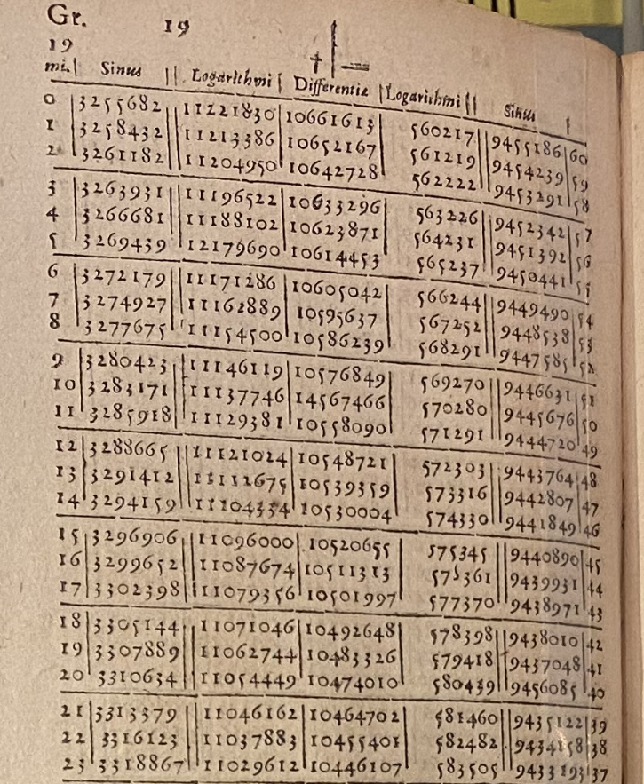
Napier’s table (edited from wikimedia)

Slide 18
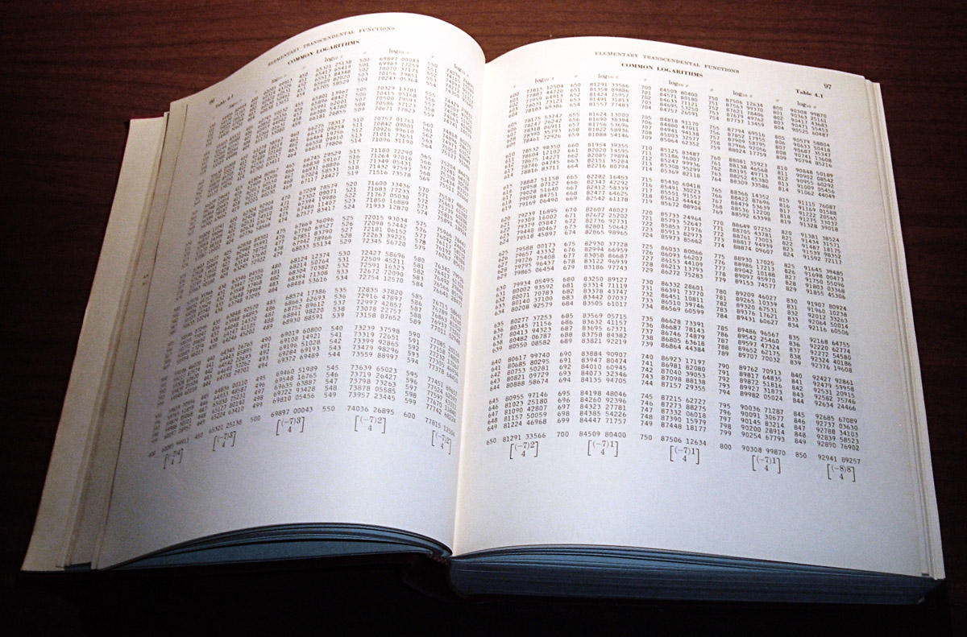
Logarithm table from 1964 (cf. wikimedia)

Slide 19
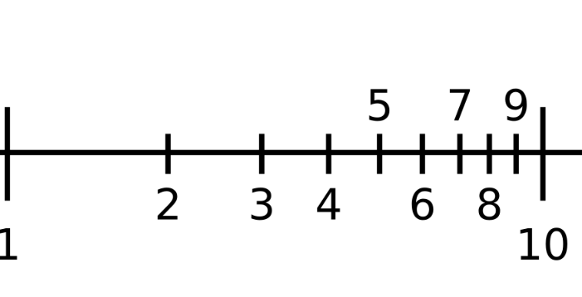
Slide rulers
Essentially two logarithmic scales atop each other, functionally equivalent to a table
log(3)
log(3) + log(2) = log(6)
→ 6 = 3x2
log(2)

Slide 20
Lessons from logarithms
Sometimes the first version of an idea is highly convoluted, like Napier’s, but gradually simplifies over time
Looking up (partial) results of calculations is extremely fast
Computers still often use look-up tables to speed computation, like the CORDIC algorithm used to calculate trigonometric functions

Slide 21
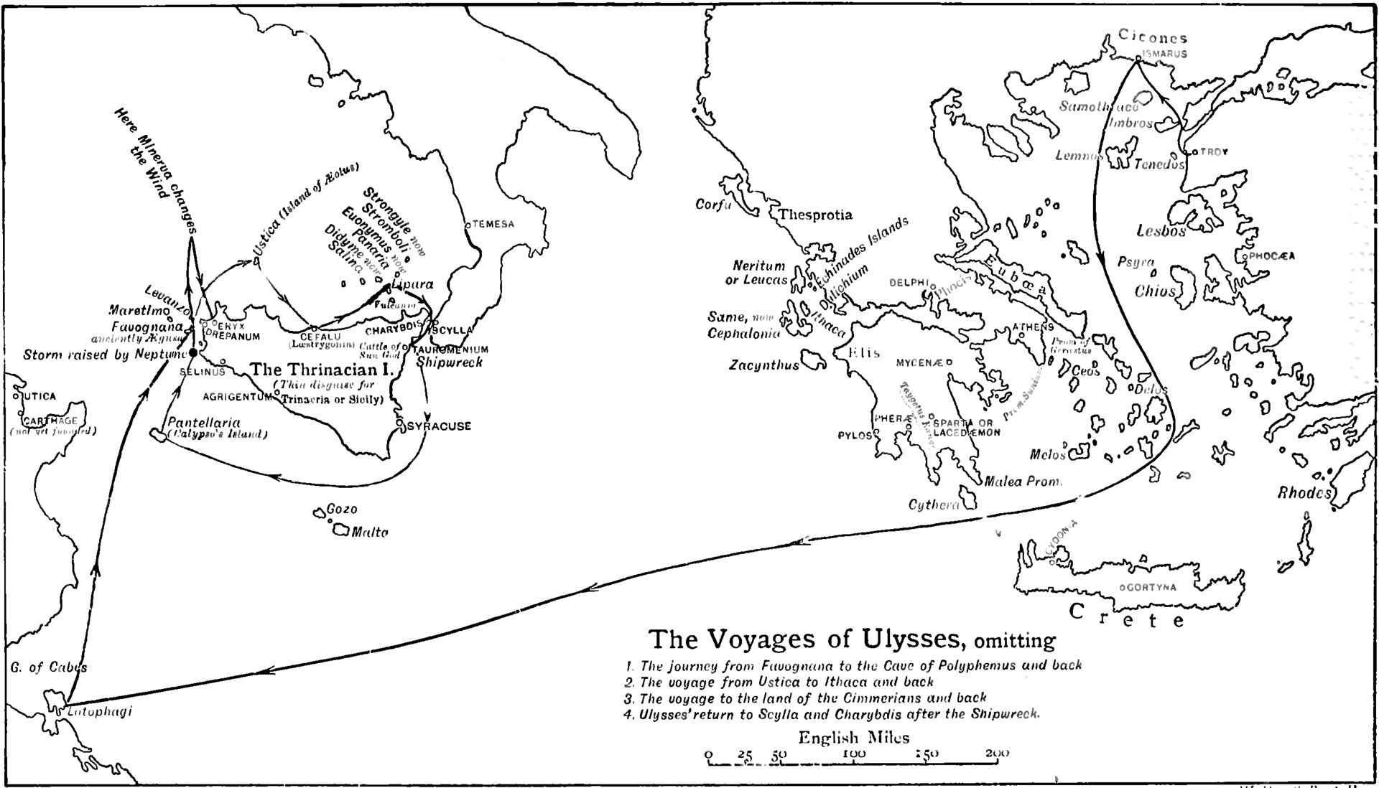
Your turn: Odysseus’s trip

Slide 22
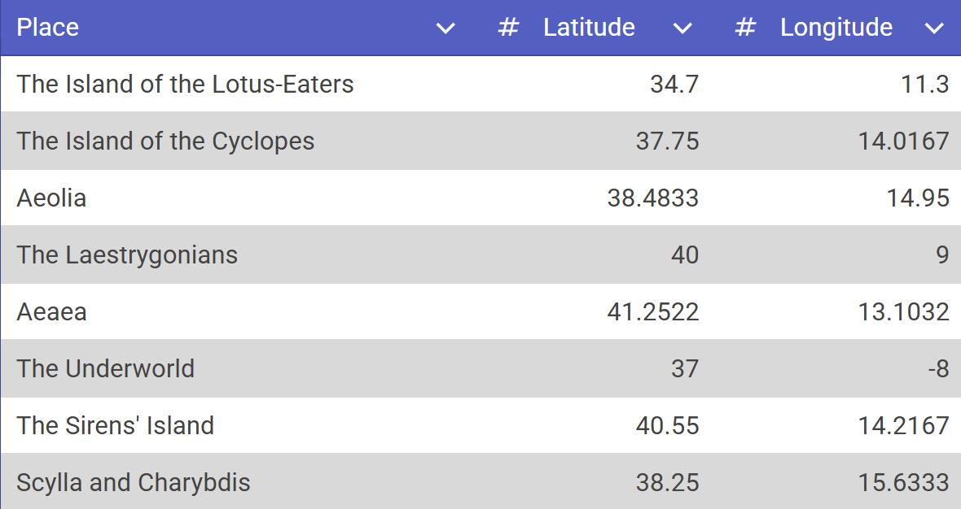
List of places Odysseus visited

Slide 23
Distance between two points on a sphere
Longitude
Latitude

Slide 24
Let’s see who is the fastest! (earth radius: 6378 km)

Slide 25
References
https://math.stackexchange.com/questions/47927/motivation-for-napiers-logarithms
https://math.stackexchange.com/questions/469074/how-was-e-first-calculated/469088#469088
https://en.wikipedia.org/wiki/Slide_rule
https://en.wikipedia.org/wiki/Logarithm
https://en.wikipedia.org/wiki/History_of_logarithms

